Slide 1
Module 2 - Dart Essentials

Slide 2
Contents
Structure
Data types
Variables
Collections
Control Flow
OOP
Null Safety
Async

Slide 3
What is Dart?
Concept
Dart is a client-optimized, class-based language by Google.
Key Points
Designed for UI frameworks (Flutter)
Multi-platform: mobile (iOS/Android), web, and desktop applications
Fast development: JIT
Fast production: AOT
Modern asynchronous model (Futures, async/await, Streams)
Notes: Relate Dart vs JavaScript vs Kotlin for context

Slide 4
Program Structure
Every Dart program starts at the main() function.
print() writes a line to the console.
void main() {
print("Hello Dart");
}
→ Hello Dart
Notes:
Use DartPad to run; stress semicolons and entry point.

Slide 5
Data Types
Type | Description
Numbers | int (whole numbers), double (fractional)
String | Text enclosed in single or double quotes
bool | Boolean value: true or false
List | Ordered collection of elements
Set | Unordered collection of unique elements
Map | Key–value pairs
null | Represents absence of a value
Object | Base class for all Dart objects
enum | Fixed list of constant values
Iterable | Abstract collection type used in loops
Never | For functions that never return (always throw)
Dynamic | Can hold any type; resolved at runtime
Void | Indicates no return value

Slide 6
Data Types
Core types: int, double, String, bool, List, Set, Map
Strong typing with generics (List<int>, Map<String, int>)
int age = 20;
double gpa = 3.75;
String campus = "FPT HCM";
bool pass = true;

Slide 7
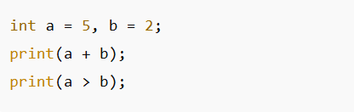
Operators
Concept
Operators allow you to perform mathematical, comparison, and logical operations.
Explanation
Arithmetic: + - * / %
Comparison: > < >= <= ==
Logical: && || !

Slide 8
Variables & Memory Concept
var = inferred type, dynamic = runtime type.
final = runtime-constant (assigned once)
const = compile-time constant
var name = "FPT University";
final year = 2024;
const pi = 3.14159;
dynamic x = 10; x = "Hello";
Notes:
Ask students to explain: when to choose final vs const.

Slide 9
Strings & Interpolation
Use $var or ${expr} to interpolate values.
String name = "FPT University";
print("Hello $name");
print("Length: ${name.length}");
Hello FPT University Length: 16
Notes:
Remind: string methods like .length, .toUpperCase().

Slide 10
Collections (List, Set, Map)
List: ordered • Set: unique • Map: key-value
Output: {1,2,3}
Nam
List<int> nums = [1,2,3];
Set<int> s = {1,2,2,3};
var user = {"id":1, "name":"Nam"};
print(user["name"]);
Notes:
Explain set uniqueness; discuss map access & missing keys.

Slide 11
Control Flow: if / else - switch
If/else: Conditional branching with boolean expressions.
Switch is clearer than many if-else for discrete cases.
var day = "Mon";
switch(day) {
case "Mon": print("Start"); break;
default: print("Other");
}
int score = 80;
if(score >= 50) print("Pass");
else print("Fail");

Slide 12
Loops: for-in & forEach
Classic counted loop.
for-in: iterate collections • forEach: functional style
for(int i=0; i<3; i++) { print(i); }
for(var x in [1,2,3]) print(x); [1,2,3].forEach((e)=>print(e));
Notes:
1 2 3 1 2 3

Slide 13
Functions: basics - arrow syntax
Typed params & return values.
Short form for single-expression functions.
int add(int a,int b){ return a+b; }
print(add(2,3));
int add(int a,int b)=>a+b;
print(add(2,3));
Notes:
5

Slide 14
Functions — optional & named params
Use {} for named optionals; provide defaults.
Output: Guest
Minh
void greet({String name = "Guest"}) { print(name); }
greet(); // Guest
greet(name: "Minh"); // Minh

Slide 15
Intro to OOP
Concept
Dart fully supports OOP
Key ideas
Class / Object
Constructor
Inheritance
Polymorphism
Method Override
Notes
OOP will be the foundation when building the Flutter widget tree UI.

Slide 16
Classes & Objects
Class defines structure; object is an instance.
Started: Toyota
class Car { String brand; Car(this.brand); void start(){ print("Started: $brand"); } } var c = Car("Toyota"); c.start();

Slide 17
Constructors - default & named
Default, named, and redirecting constructors.
class Point { int x,y; Point(this.x,this.y); Point.origin(): x=0, y=0; }
var p = Point.origin();

Slide 18
Inheritance & Override
Use extends to inherit and @override to change behavior.
class Animal {
void sound()=>"Some";
}
class Dog extends Animal { @override void sound()=>"Woof";
}
Dog()..sound();

Slide 19
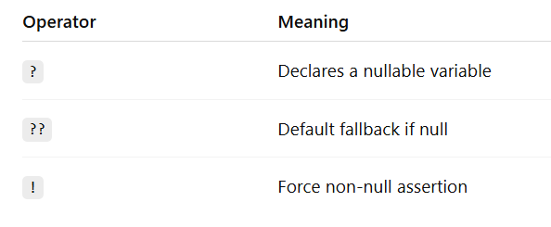
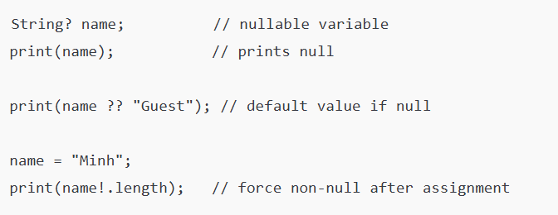
Null Safety - operators ?, ??, !
Dart enforces null-safety at compile-time to prevent null reference errors.
Example:
Notes:
null
Guest
4

Slide 20
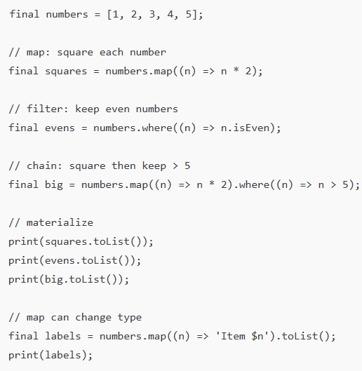
Collections - map/filter
Concept: Functional operations over iterables (e.g., map, where)
map: transform each element → new Iterable
where (filter): keep elements that satisfy a predicate
Often chained; lazy until consumed (toList, forEach, etc.)
Explanation
Works on any Iterable<T> (e.g., List, Set)
map preserves length, transforms type
where preserves type, may change length
Use toList() or toSet() to materialize results
Notes:
[2, 4, 6, 8, 10]
[2, 4]
[6, 8, 10]
[Item 1, Item 2, Item 3, Item 4, Item 5]

Slide 21
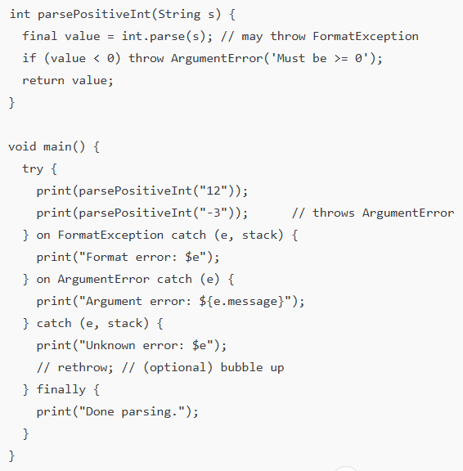
Exceptions — try/catch/finally
Concept: Handle runtime exceptions without crashing the application.
try: the risky block
catch / on: handle exceptions
finally: always runs (cleanup)
rethrow to propagate after logging
Explanation
Use on SpecificException to target types
catch (e, s) captures error + stack trace
Prefer throwing custom exceptions for domain errors
Example:
Notes:
12
Argument error: Must be >= 0
Done parsing.

Slide 22
Async — Future & async/await
async marks an async function; await pauses until Future completes.
Future<String> fetch() async { await Future.delayed(Duration(seconds:1)); return "Done"; }
void main() async { print(await fetch()); }
Notes:
Discuss event loop and microtasks briefly.

Slide 23
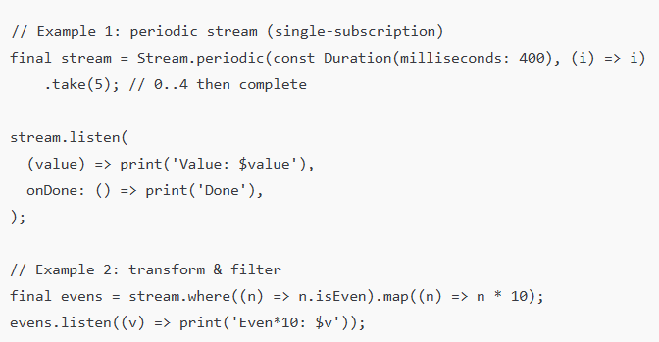
Streams — sequence of async values
Exam:
A Stream emits a sequence of asynchronous values over time.
Single-subscription (default): one listener, sequential consumption.
Broadcast: multiple listeners, events shared.
Explanation:
Subscribe with listen, cancel with subscription.cancel().
Transform with **map / where / take / debounce (package)`.
Consume with await for inside async functions.

Slide 24
Mini-lab - Student list
Task: create Student class, store in List, print, then add async delay to simulate loading.
class Student { String name; Student(this.name);} void main() async { var list = [Student("An"), Student("Binh")]; await Future.delayed(Duration(seconds:1)); list.forEach((s)=>print(s.name)); }
Notes:
An Binh

Slide 25
Summary
We covered:
Dart structure
data types -Variables
Collections
Control flow
Functions
OOP
Null safety
Async programming and streams.
Notes:
Common Pitfalls: Forgetting semicolons , Ignoring null-safety warnings, Mixing sync/async incorrectly
Prefer final over var when possible, Type your variables, Handle nulls with ??, Use async/await instead of callbacks

Slide 26
References
Mastering Flutter (2025), Chapter 2
docs.flutter.dev
dart.dev/tools/dartpad

